Slide 1
Object-Oriented Software Engineering
Object Oriented software Testing
Roll No:19
Roll No:20

Slide 2
An Overview of Testing
Testing is defined as the activity to check whether the actual results match the expected results and to ensures that software is defect free
50% of development effort is being spend

Slide 3
Test types
Unit testing
Integration testing
System testing
Regression testing
Operation testing
Full-scale testing
Performance testing
Stress testing
Negative testing
Test based on requirement specification
Ergonomic tests
Testing of user documents
Acceptance testing
Alpha testing
beta testing

Slide 4
Test types
Unit Testing--one and only one unit is tested
Integration testing—units are working together correctly
System testing—integrated whole system working correctly
Regression test– when made changes in system, to verify the old functionality remains
Operation test—if system has to be reconfigured during operation, should be tested.
Measures reliability of system
Full scale test—run program in maximum limits
Many simultaneous users , use cases , equipments are connected

Slide 5
Test types
Performance test—measure the performance with different load
e.g. Store allocation , CPU utilization , speed
Stress testing
Stress test—
extreme limits of system
an overload test
Negative test—
perform to break the system and verify the response of application during unwanted inputs
Requirements specification test—
check explicitly requirement specification
Ergonomic test—user support and usability test
Is the interface consistent between several interfaces?
Are the menu readable?

Slide 6
Test types
Testing of user documents– user manual and documentation for maintenance should be checked
For language
Readability test
Balance between text
Balance between text and picture
Acceptance testing—tested with real data
Alpha testing—user of the software work with development team in developer’s site
Beta testing—all user to experiment in user’s site

Slide 7
Inspection and testing
inspections
Requirements
specification
Software
architecture
UML
diagram
model
Database
schemas
program
System
prototype
Testing
fig: inspections and testing

Slide 8
inspection
Inspection and reviews can be more cost effective than testing for discovering interface errors
Inspection mostly focus on the source code of the system ,requirement and design model
A single inspection can discover many errors in a system
Incomplete version of software can be inspected without additional cost
look for inefficiencies , inappropriate algorithms , poor programming styles that could make system difficult to maintain.

Slide 9
input
output
Test program
Expected output
tested unit
Fig : Schematic illustration of automated testing
Test program: regard them as part of product but placed in separate block
Use for further maintenance of system
To Perform regression test

Slide 10
Use of interface simulator
To obtain simple interface to system and make test program independent of the system Interface simulator or test driver is built
Interface simulator saves works since handling of the interface of system in target environment
Test
program
System block
Interface
simulator
Test data
Fig: user of and interface simulator

Slide 11
Test reports
Test cases
Test data
Test result
Design test cases
Prepare test data
Run program with test data
Compare result with test cases
Fig: A model of software testing
Typically a commercial software system has to go through three stages of
Testing:
Development testing
Unit testing
Component/integration testing
System testing
Release testing
User testing

Slide 12
Development testing
Development testing includes all testing activities that are carried out by the team developing the system.
Testing group are responsible for developing tests and maintaining the test details.
Testing carried out at the three level of granularity:
Unit testing
Component testing(integration)
System testing

Slide 13
System
Sub System
Integration Testing
Service package
Blocks
Unit Testing
Class
Fig: unit testing and integration testing are made on different levels
NOTE that service package and blocks are tested in both manners

Slide 14
Testing activities
construction
Testing
system
system
Sub system
sub system
Use case
Use case
Service packages
Service packages
blocks
blocks
classes
class
Fig: testing activities performed

Slide 15
a) Unit testing
Process of testing units:-
classes
Individual methods/functions
Blocks
Service packages
Test is design to provide coverage of all features of the object
Test all operation associated with the object
Set and check the values of all attributes associated with the object
Put the object into all possible states

Slide 16
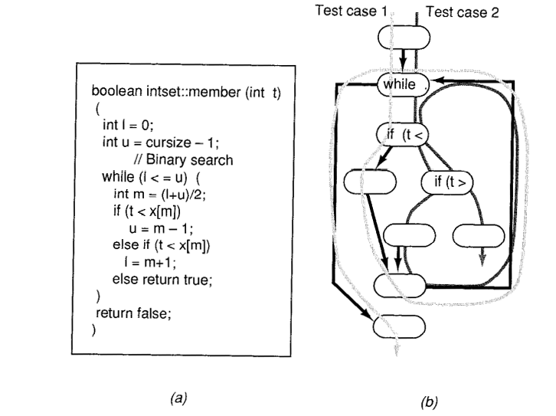
Structural testing
Test internal structure is correct
measures of test coverage
Least coverage is to exercise each decision-to-decision path at least once e.g. IF-statement
Loops must be given extra cares
Fig: the member function in (a) can be tested with only two test
Cases illustrated in(b) to do a full cover of each DDpath
unit test cont….

Slide 17
Structural testing cont……
polymorphism
Dynamic binding : runtime binding/late binding
E.g.
Class member{
…………………..
Abstract boolean validate payment ( account a , int amount , card c );
……………………….
}
Gold member
Silver member
Bronze member
Nepal Acc
China Acc
Pakistan Acc
EU Acc
Japan Acc
Visa card
Debit card
AM express card
3*5*3=45 possible combination of dynamic binding
Often difficult to find and test all binding that may occurs
unit test cont….

Slide 18
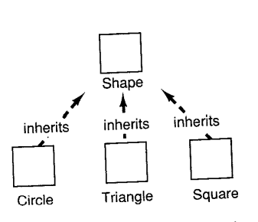
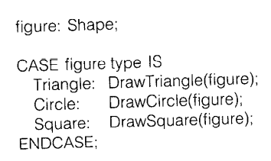
Structural testing cont……
Polymorphism
Fig : a class hierarchy of shapes
Declare a variable figure of type shape
Descendants all have a Draw operation
Then assign figure to an object of any of shape’s descendants
Cont…..

Slide 19
Structural testing cont…..
Inheritance
Not only when we modify an ancestor class must we re-test the descendants, but also when we added a new descendent we may need to re-test inherited operations
class A {
Protected int x= 200; // invariant x>100
…………………………………
Void m()
{ ………………… //correctness depends on variable }
}
Class B extends A {
Void m1() {x=1,2,3,…….}
}
Above condition is not defined here
unit test cont….

Slide 20
class Parent:
def f1(self):
print("Function of parent class.")
class Child_1(Parent):
def f2(self):
print("Function of child_1 class.")
class Child_2(Child_1):
def f3(self):
print("Function of child_2 class.")
obj_1 = Child_1()
obj_2 = Child_2()
obj_1.f1()
obj_1.f2()
print("\n")
obj_2.f1()
obj_2.f2()
obj_2.f3()
Multi level inheritance
Child_1 has access to functions f1() and f2()
And
Child_1 has access to functions f1() , f2(), f3()
If Try to access function f3() using object class_1
Then error will occurs.
Need to develop unique test cases for every level in inheritance

Slide 21
Structural testing cont…..
Overridden
Class A{
Void m() {………… m2(); }
Void m2() {……..}
}
Class B extends A {
Void m2() {…………….}
}
M() calls m2()
Class B has overridden method m2()
M() is called in context of class B due to dynamic binding B.m2() is called
Can’t be sure that m() is correct anymore
We need to re-test it with B instance
unit test cont….

Slide 22
Structural testing cont…..
To test Abstract class focus on two properties
We must test that we can inherit the class and That we can create instance of the descendant
We must test any stimuli sent to the object itself work properly
unit test cont….

Slide 23
II. Specification testing
Contains the conditions for the tests Which control testing instead of test out comes
Which test in which order
Detail description of how the test shall be performed
Specify expected output
Criteria for an approved test
Report skeletons are prepared prior to the testing

Slide 24
State-Based testing
State-Based testing
While messaging passing from one object to another or receiving message from object perform some tasks (operation) which leads to alternation of it’s state

Slide 25
State-Based testing
Order received
Unprocessed order
Checked (reject)
Checked (accept)
Reject order
Accept order
Checked (pending)
Checked (fulfilled)
Fulfilled
order
Pending
Figure: example of state model

Slide 26
Choosing unit test cases
Guideline testing
What kind of test cases are effective for discovering errors
Guidelines reflects previous experience of the kinds of error that programmers often make when developing components
Some guidelines:
Design inputs that cause input buffer overflow
Force computation result to be too large or too small
Choose inputs that force to generate all error messages.
Repeat the same input or series of inputs numerous time
Force invalid outputs to be generated.

Slide 27
Choosing unit test cases
Equivalence Partition testing
Identify groups of input that have common characteristics and should be processed in the same way
Divides the input data of a software unit into partitions of equivalent data from which test cases can be derived
Input equivalence partitions
Inp
To reduce number of testes that we need to perform
Select reasonably small number of test cases
Probability of fault finding is high
E.g. We write test cases for stack , we may write tests cases for when stack is empty and loaded or full
Output partition
system
Possible inputs
Possible outputs
Test cases are designed such so that inputs and outputs lies with in this partitions

Slide 28
Identify partition by using the program specification or user documents
And from experience where predicted the classes of input values that are
likely to detect errors
3
7
11
10
4
Between 4 and 10
Less than 4
More then 10
Numbers of input values
100000
9999
10000
50000
99999
Between 10000 and 99999
Less than 10000
More then 99999
Input values
Fig: equivalence partitions

Slide 29
b) integration testing
Blocks, service packages , sub systems are tested
Perform by programmer or testing groups
Use use cases
Purpose of verifying that units are working together correctly
The order in which the subsystems are selected for testing and integration determines the testing strategy
Bottom up integration
Top down integration
Sandwich testing

Slide 30
integration testing
Test cases are applied to the interface of the composite component created by combining components
Different interface errors may occurs
Parameter interface:-data or function references are passed from one component to another
Method in an object have a parameter interface
Shared memory interface:- block memory shared between components
Data is placed by one sub system and accessed by other sub system

Slide 31
Integration testing
Procedural interface:-one component encapsulate a set of procedures that can be called by another components
Object and reusable components have this form of interfaces
Message passing interfaces:- one component request message from another component by passing message
Test Cases
A
B
Fig : interface testing
C

Slide 32
c) System testing
System testing checks the components are compatible , interact correctly and transfer the right data at the right time across their interfaces.
System testing may involve separate testing teams with no involvement from designer and programmers.
Because of focus on interactions , use case based testing is an effective approach to system testing.

Slide 33
System testing
Includes following testes :
Operation testing
Full scale testing
Negative testing
Test based on requirement specifications
Test of user documents

Slide 34
System testing cont …….
Weather information system
Sat comms
Weather station
Comm slink
Weather data
Request (report)
acknowledge
Report weather()
acknowledge
get (summary)
Summaries ()
Reply(report)
Send (report)
acknowledge
acknowledge
Fig: collect weather data sequence chart
Weather station is asked to report summarized weather data to a remote computer
Sat comms : request weather station: report comm slink : get (summary) weather data : summarized.

Slide 35
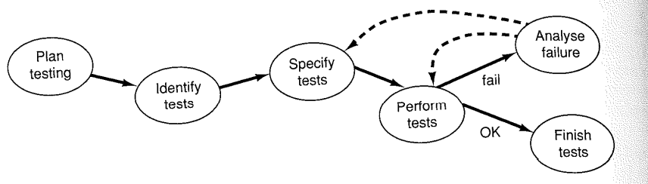
Fig: activities in integration/system testing

Slide 36
Test planning
Testing guide lines established
Automatic or manual testing
When requirement model is ready start test planning
Existing test program data can be used?
Determine what degree of coverage of our test have
Test incrementally
Test log kept during entire test work(brief survey history of test activities)

Slide 37
Test identification
To find out What shall be tested ?
Use case initially tested separately
Use cases constitute an excellent tools for the integration test , explicitly interconnect several blocks and service packages
For use case following tests:
Basic course tests– expected flow of events
Odd course tests
Tests based on requirement specifications
Test of user documents
Regression test

Slide 38
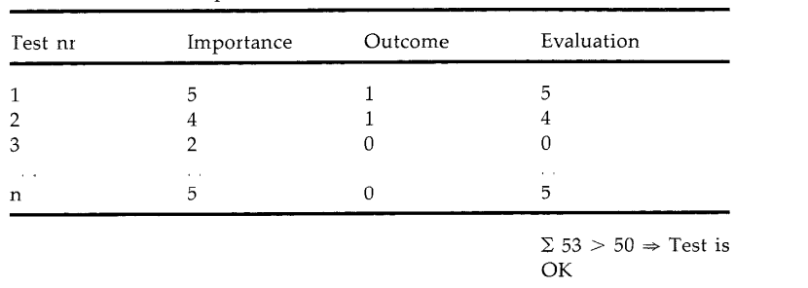
Test execution
As soon as some use cases are approved test execution started
Test as much as possible in parallel
By automatic testing and manual testing
decision table: get assessment of result of the tests
Evaluation is sum up and compare to limit value
If sum exceeds this value then , test have approved the test object
Test report is prepared: result of individual subsets , resources spend ,
action taken.

Slide 39
Error analysis
Test must be analyzed and reason of the fault identified
Fault need not be due to system , but of some cases:
Has the test been performed correctly?
Is there fault in test data or test program?
Is the failure caused by test bed?
After test deficient blocks should be send to designer

Slide 40
Test completion
After testing being completed , the equipment and test bed should be restored for re use again
Documentation prepared should be saved
Experiences of testing are collected and discussed in order to learn for future test activities
Concluding notes are made and filed

Slide 41
2) Release testing
Release testing is the process of testing a particular release of a system that is intended for use outside of the development team.
Objective is to check that the system meets it’s requirements
called ‘functional testing’ because the tester is only concerned with functionality and not the implementation of the software

Slide 42
Release testing cont …….
Requirement based testing: requirement based testing is validation
Scenario testing :in software testing is a method in which actual scenarios are used for testing the software application instead of test cases.
Performance testing : is the practice of evaluating how a system performs in terms of responsiveness and stability under a particular workload. Performance tests are typically executed to examine speed, robustness, reliability, and application size.

Slide 43
c)User testing
User or customers provide input or advice
In practice there are three types of user testing:-
Alpha testing: user of the software work with the development team to test the software at the developer’s site
Beta testing: release of software is made available to users to allow them to experiment and to raise problems that are discovered with system
Acceptance testing: customers test a system to decide whether or not it is ready to accepted from the system developers and deployed in the customers.

Slide 44
Test criteria
Test plan
tests
Test results
Testing report
Define acceptance criteria
Plan acceptance testing
Derive acceptance testing
Accept or reject system
Run acceptance tests
Negotiation test results
Fig: Acceptance testing process
Acceptance testing:
tested with real data
Alpha testing—user of the software work with
development team in developer’s site
Beta testing—all user to experiment in user’s site

Slide 45
Thank you

